Slide 1
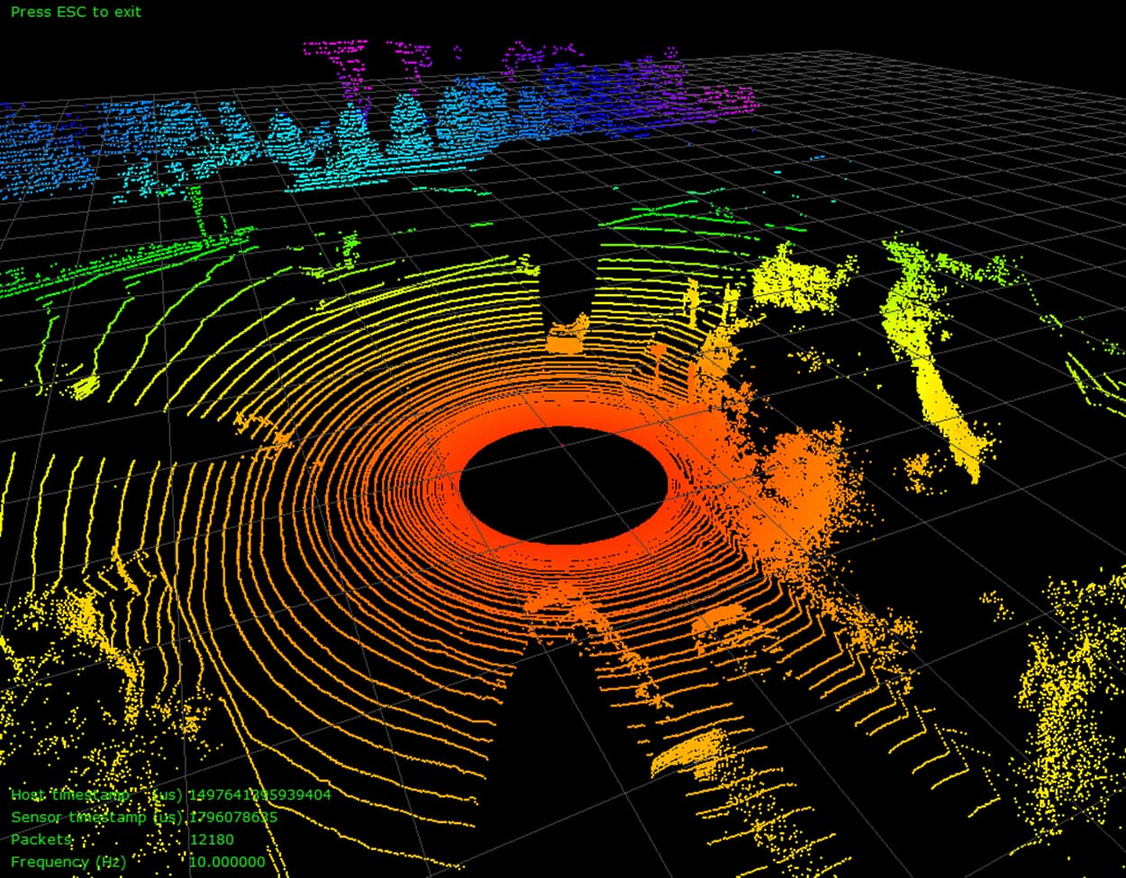
EECE5554 - ROBOT SENSING AND NAVIGATION
ORB SLAM -3
Group 11
M.A. Razaq Khan | Tejasri K | M. Irfan Ali | Adnan Amir

Slide 2
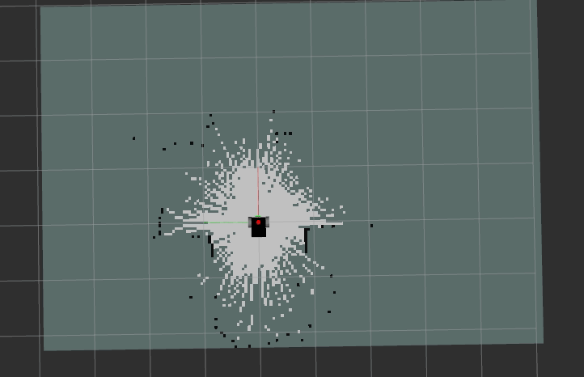
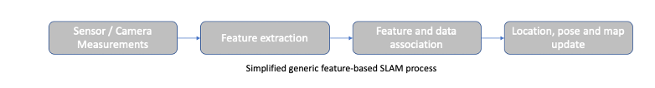
What is SLAM?
SLAM is a process where a mobile robot creates and utilizes a map to determine its location in an environment.
Both the trajectory of the platform and the location of all landmarks are estimated without a priori knowledge of location.
SLAM has two parts
Localization
Mapping

Slide 3
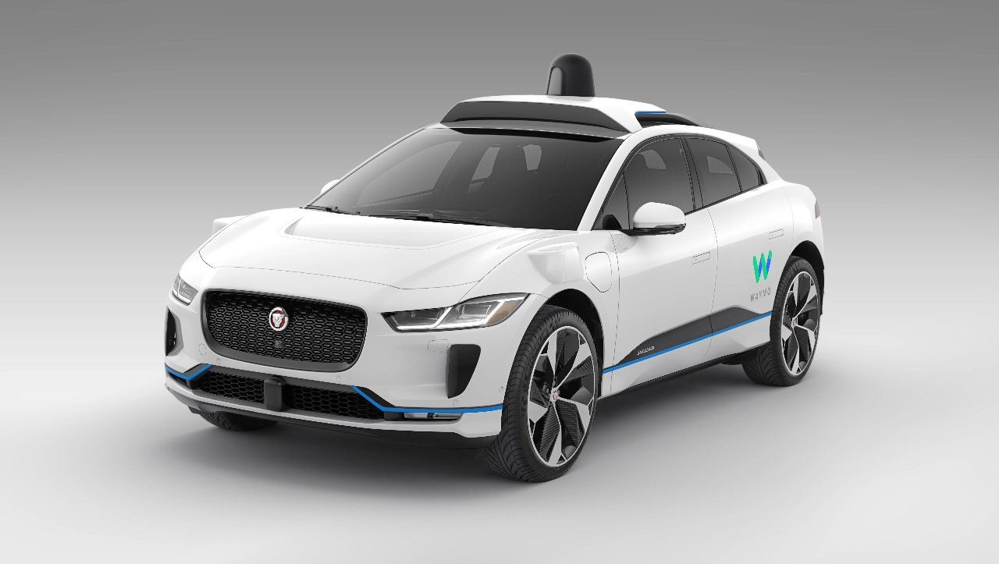
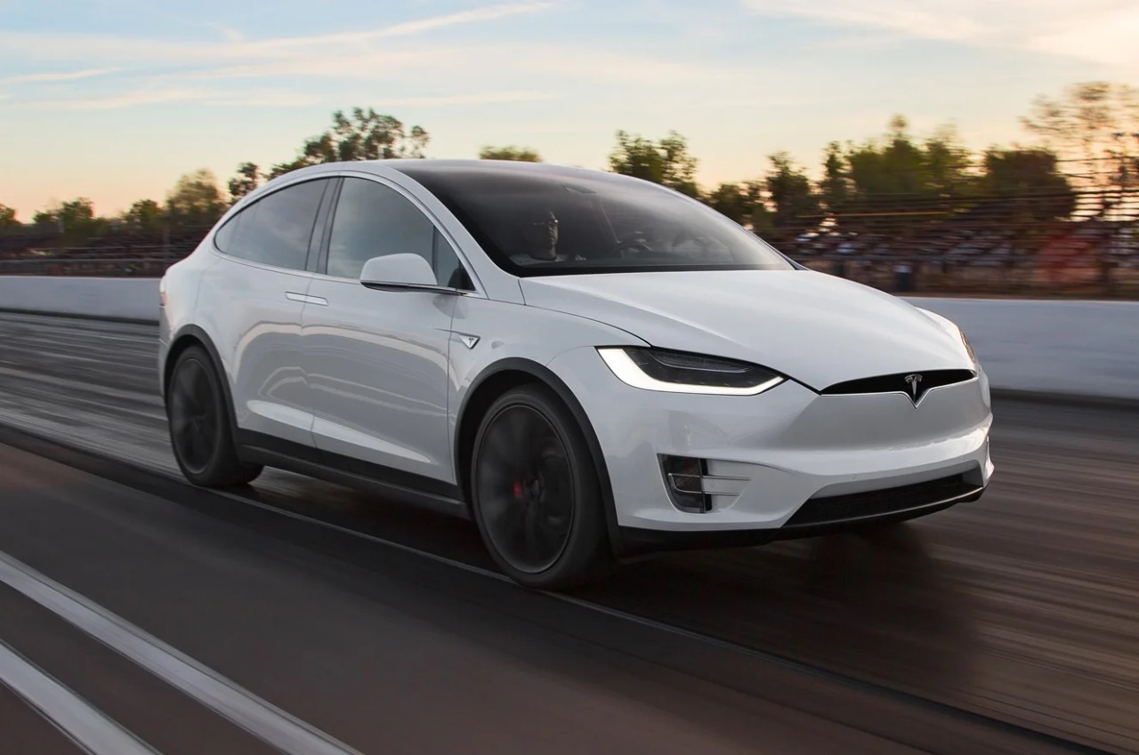
Lidar SLAM or Visual SLAM?

Slide 4
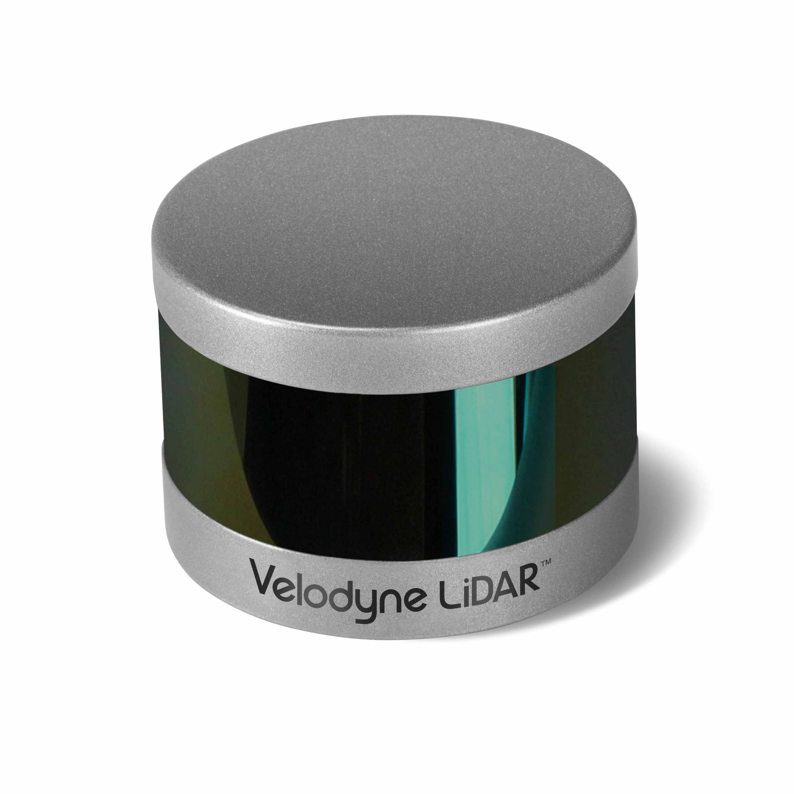
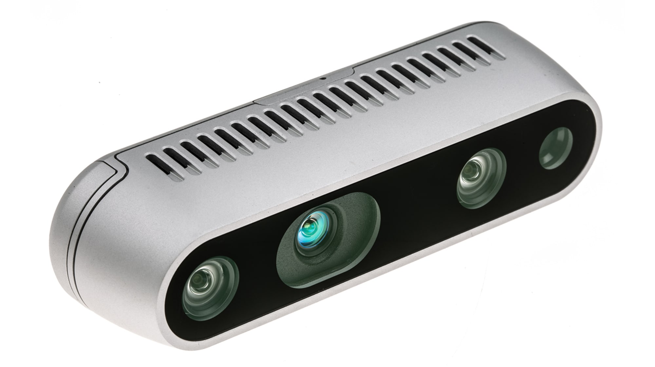
Lidar SLAM Vs Visual SLAM
Accuracy: LIDAR sensor can measure distances with high precision.
Reliability: LIDAR sensors are less affected by environmental factors.
Speed: Visual SLAM is faster than LiDAR SLAM due to quicker image capture, influenced by system computational power and environmental complexity.
Cost: LIDAR sensors are more expensive and require more processing power.

Slide 5
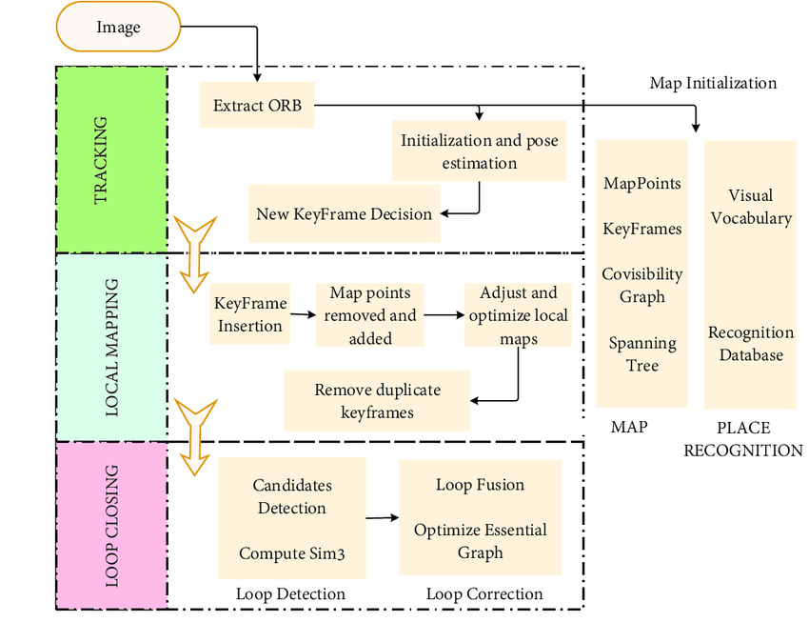
Understanding ORB-SLAM
ORB-SLAM comes from Oriented FAST and Rotated BRIEF (ORB) features to detect and match keypoints in images.
Combined techniques, such as loop closing and pose optimization, to achieve robust and accurate localization and mapping.
The system is divided into three threads
Tracking
Local mapping
Loop closing

Slide 6
ORB-SLAM to ORB-SLAM 3
Key Features: ORB-SLAM
Accurate Monocular SLAM solution
ROS is integrated
Map initialization and tracking using keyframe-based methods.
Key Features: ORB-SLAM 2
Enhanced support for Monocular, Stereo and RGB-D cameras
ROS is optional
Improved tracking and mapping accuracy and optimization.
Loop closing for global consistency.
Key Features: ORB-SLAM 3
A monocular and stereo visual-inertial SLAM system
Improved-recall place recognition
ORB-SLAM Atlas
An abstract camera representation

Slide 7
ORB-SLAM 3
It is a feature-based tightly-integrated visual-inertial SLAM system.
It is a multiple map system that relies on a new place recognition method with improved recall.
Reuse in all the algorithm stages all previous information.
• Short-term data association
• Mid-term data association
• Long-term data association
• Multi-map data association

Slide 8
ORB-SLAM 3
The main techniques used for estimation and data association:
Visual SLAM:
Visual-Inertial SLAM:
Multi-Map SLAM:

Slide 9
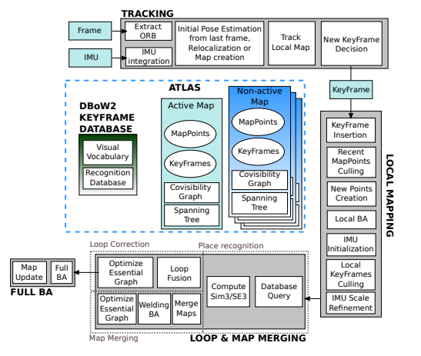
SYSTEM FRAMEWORK
Main system components of ORB-SLAM3.
Tracking
Mapping
ATLAS
Loop Cloosing

Slide 10
Tracking
The goal is to get Pose (T), Velocity(v) and biases(b)(assumed to be brownian)
Done using VO, IO and VIO (IMU Initialization)
In VO
Good initial estimate but the map scale is bad
Extracts features using ORB algorithm
Creates a keyframe
Performs visual only bundle adjustment to estimate the pose
In IO
Scale converges fast when treated as an optimization variable in BA
Uses Pose estimated from VO and IMU measurements
Calculate a term called inertial residual
Solve the optimization problem to get pose

Slide 11
Tracking
Re-Localization
In VIO
Combines VO and IO into a single optimization problem
Uses IMU pre-integration to calculate Inertial Residual
Combines Visual and Inertial residuals to form an optimization problem
Solves problem using factor graphs to get the required pose
If tracking is lost for 20s, new map created
If new map tracking is lost 15s after IMU initialization, map is discarded
Required to find the position based on previous info when tracking fails
Uses an algorithm called Max Likelihood Perspective n Points (MLPnP)
MLPnP works on any type of camera

Slide 12
Place Recognition
Find Candidate Key frames
Look for nearby Keyframes with similar matching map points
Compute Transformation using RANSAC to align map points and choose best transformation
Refine the Transformation by solving a nonlinear optimization problem
Verify false positives
Verify gravity vector
If this is done, the algorithm goes into map merging

Slide 13
Loop closing/Map Merging
Transformation is applied to 2 maps to be merged in a small region
Merged maps transition into the new active map
Common map points are removed to avoid duplicate points
Local BA is performed in the welding window
Once the maps are merged the poses are recalculated by optimizing the new essential graph

Slide 14
CAMERA MODEL and CALIBRATION
ORB-SLAM assumed in all system components a pin-hole camera model.
SLAM systems rectify either the whole image, or the feature coordinates, to work in an ideal planar retina.
This forces to crop-out the outer parts of the image, losing the advantages of large Field of View
Relocalization:
ORB-SLAM solves the relocalization problem by setting a Maximum Perspective-n-Point algorithm (MLPnP) that is completely decoupled from the camera model as it uses projective rays as input.
Non-rectified Stereo SLAM:
Considering the stereo rig as two monocular cameras having:
1) a constant relative SE transformation between them, and
2) optionally, a common image region that observes the same portion of the scene.

Slide 15
VISUAL-INERTIAL SLAM
ORB-SLAM-VI provides a fast and accurate IMU initialization technique with pin-hole and fisheye cameras.
IMU Initialization:
Vision-only MAP Estimation
Inertial-only MAP Estimation
Visual-Inertial MAP Estimation

Slide 16
VISUAL-INERTIAL SLAM
Tracking and Mapping:
Tracking solves a simplified visual-inertial optimization where only the states of the last two frames are optimized, while map points remain fixed.
Robustness to tracking loss
visual-inertial system enters into visually lost state when less than 15 point maps are tracked, and achieves robustness.
If the system gets lost within 15 seconds after IMU initialization, the map is discarded.
This prevents to accumulate inaccurate and meaningless maps.

Slide 17
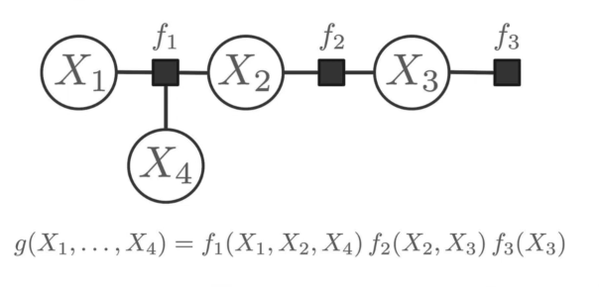
FACTOR GRAPHS
Bi-partite graph.
Simplification of Probability Distributions.
Used to visualise independence relations between variables.
Efficient execution of inference tasks.
Used to solve least-square problems.

Slide 18
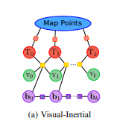
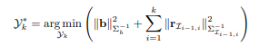
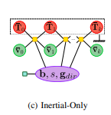
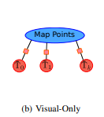
FACTOR GRAPHS
T: Pose
v: Velocities between keyframes
b: Accelerometer and gyroscope biases

Slide 19
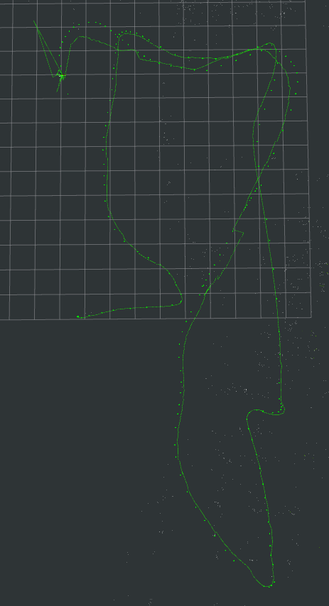
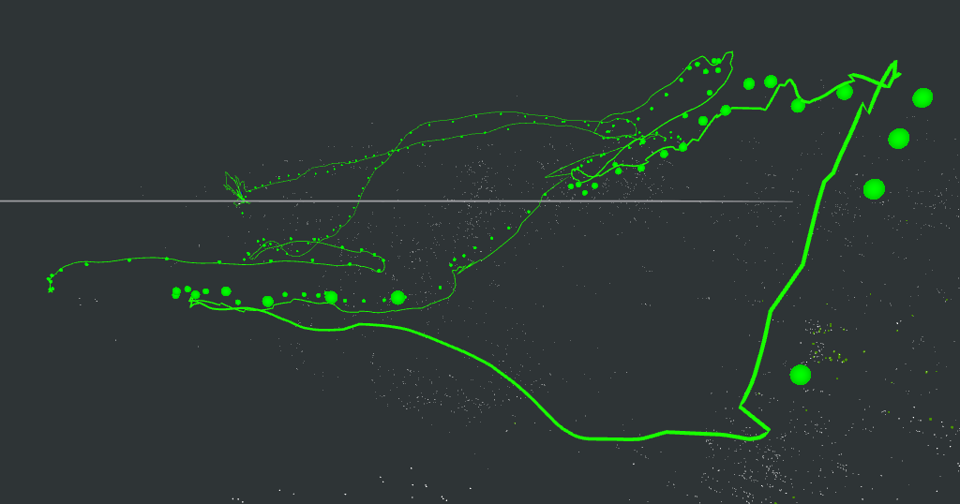
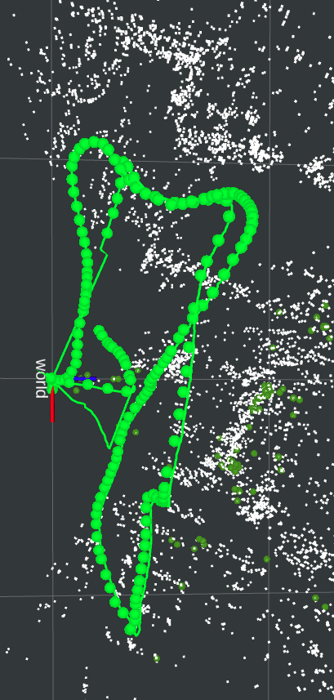
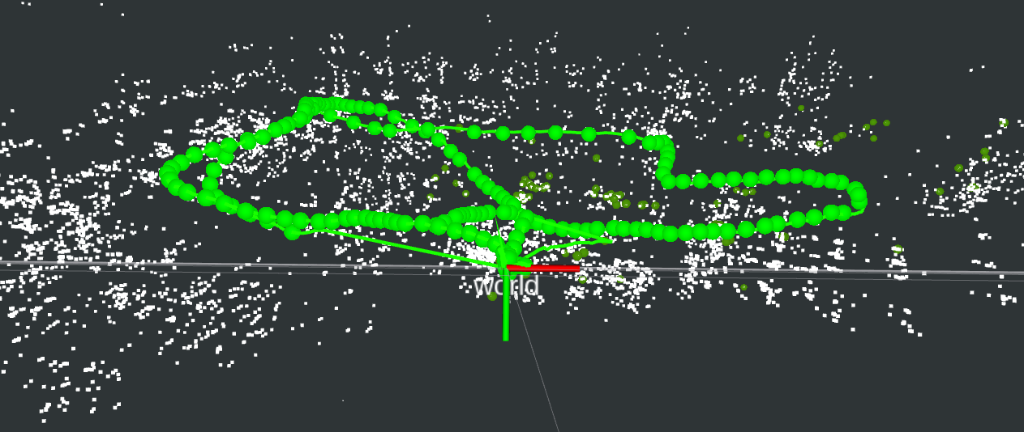
EUROC DATASET
Monocular + IMU Mode
Monocular Mode

Slide 20
Indoor Snell Dataset
Access all the videos here

Slide 21
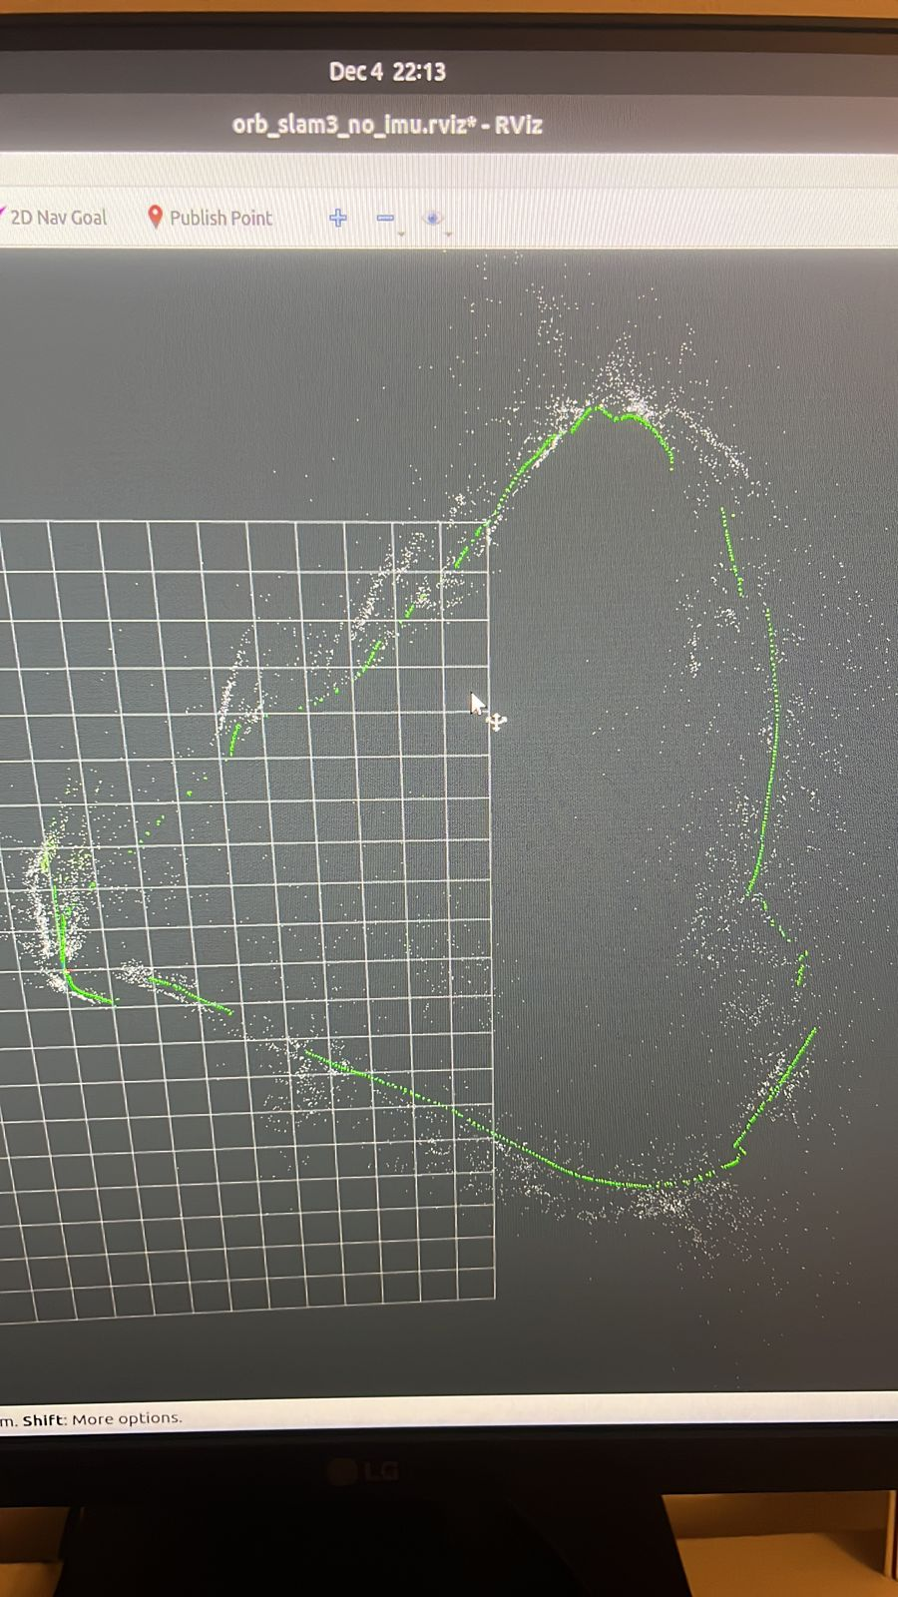
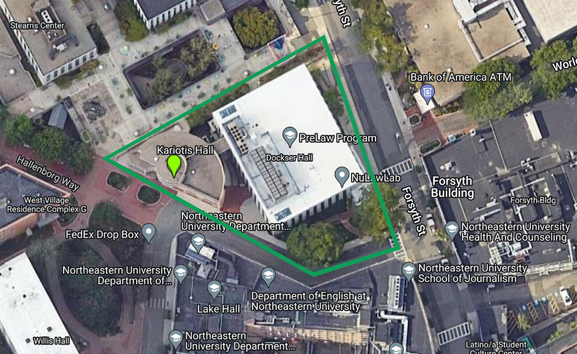
Outdoor Dataset
Access all the videos here

Slide 22
CHALLENGES
Pangolin is not supported by every system and makes everything crash if its not disabled (it is required to build)
Monocular mode is REALLY inconsistent
Faces challenges in handling dynamic environments and large-scale mapping.
Sudden Camera movement in corners loosing mapping points.
Some failure cases under challenging conditions such as weak and repetitive texture, and bad illumination.

Slide 23
FUTURE IMPLEMENTATION
Integration of an object detection module for semantic segmentation
Test out a monocular depth detection algorithm to see if it performs any better
Fuse Lidar odometry with Visual Inertial Odometry
See if any of the above can give us the full path taken by NUANCE dataset

Slide 24


